Slide 1
[WIP] NF Results
Last updated: 04/05/2024

Slide 2
Problem
Neurofilament-derived brush comprised of one or more of:
Light (156 residues) sidearm
Medium (438 residues) sidearm
Heavy (647 residues) sidearm
Response to ionic strength characterized by brush height measured through AFM
Question: role of each sidearm on overall morphology of brush and translation to biological neurofilaments

Slide 3
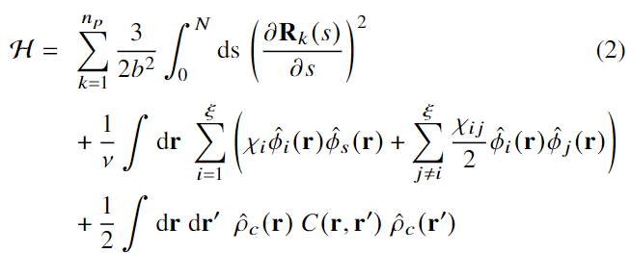
Model
Interactions
Self-consistent field theory for charged multiblock macromolecules
Coupled system of 5 algebraic equations and 2 partial differential equations
Elastic energy
Flory-Huggins (Hydrophobicity)
Electrostatics

Slide 4
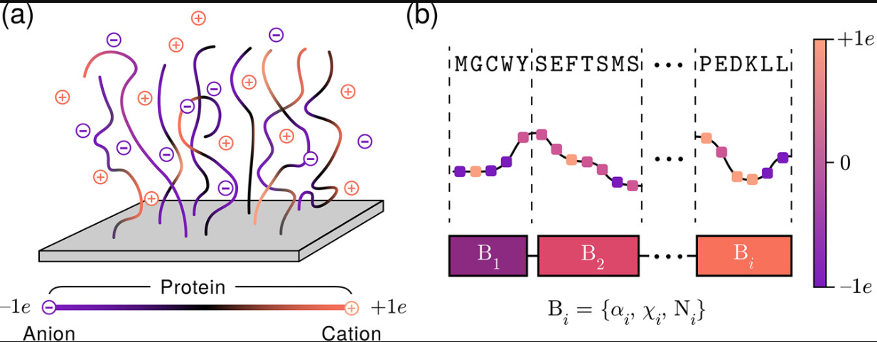
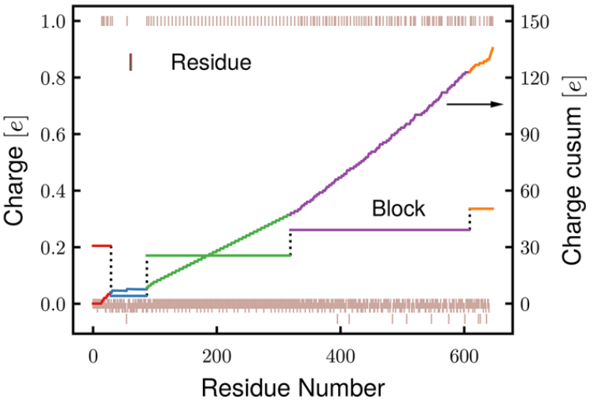
System
Protein → Multiblock charged macromolecular model
Coarse-graining by grouping similar neighboring charges (cusum method)
Yokokura et al. Biomacromolecules. 2024

Slide 5
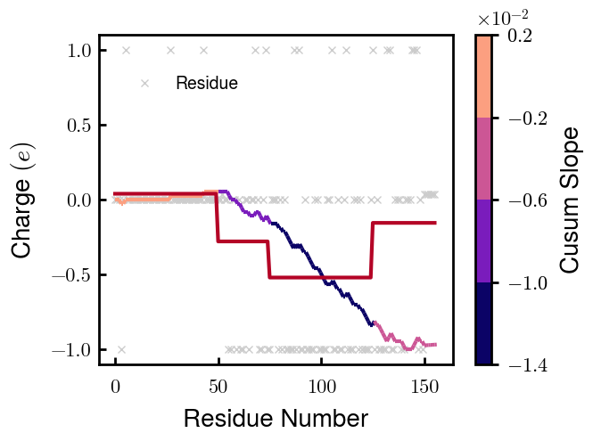
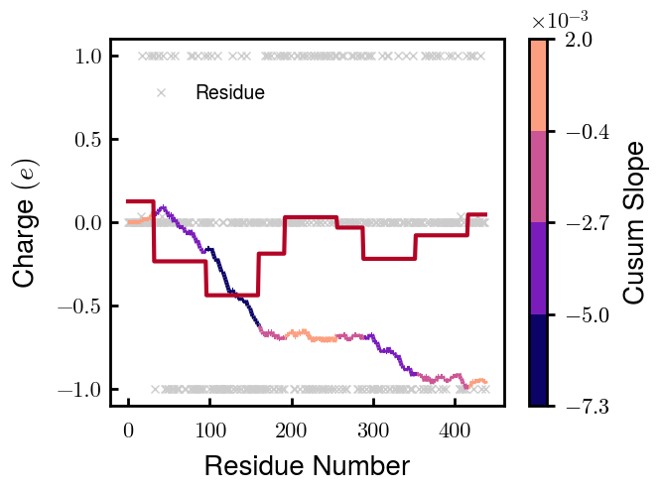
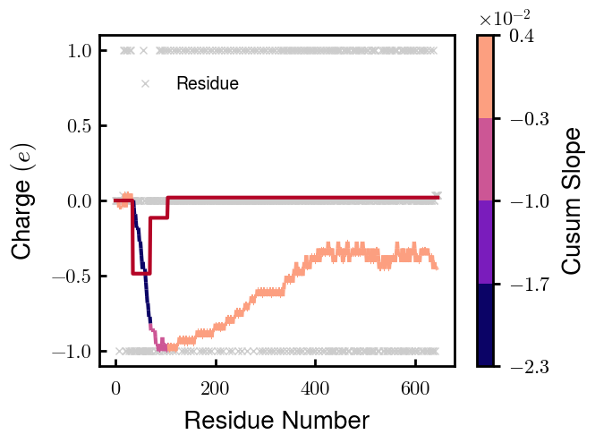
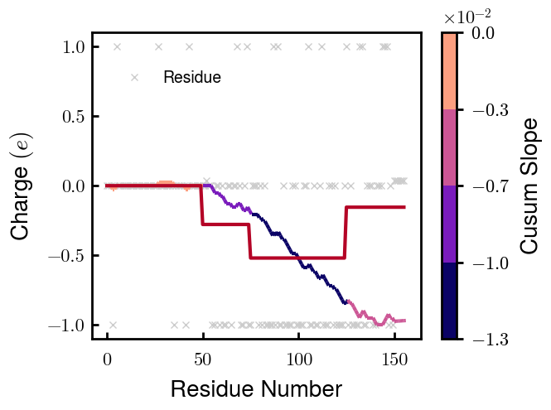
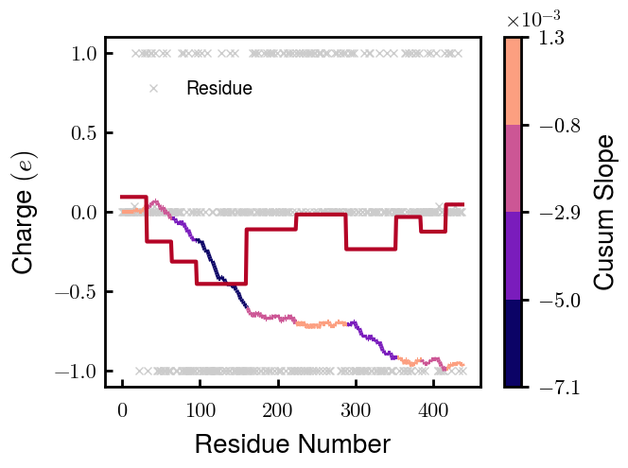
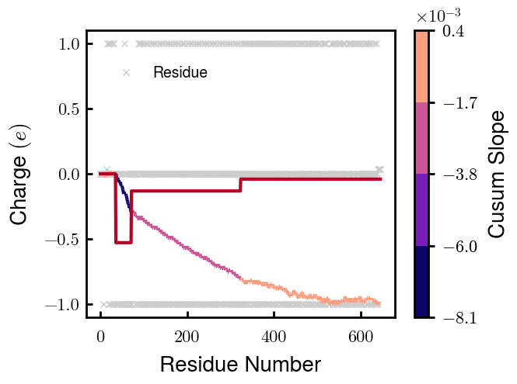
Coarse-grained Sequences (1 of 2)
NFL
NFM
NFH
Non-phospho
Phospho
Note: phospho $=−1e$ chosen for best agreement with experimentally measured heights

Slide 6
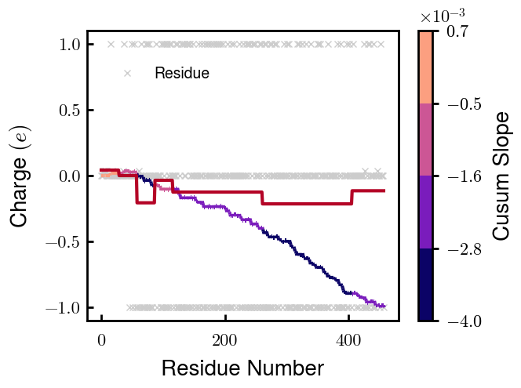
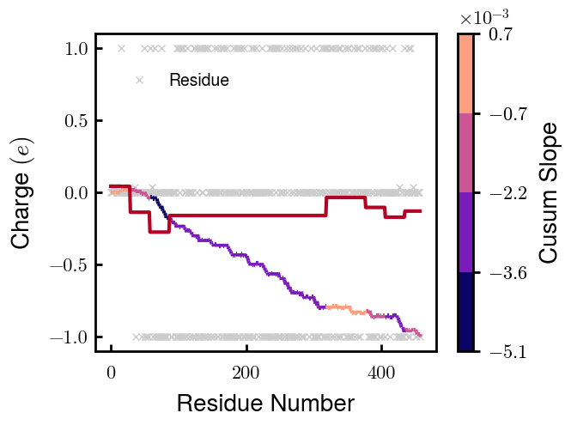
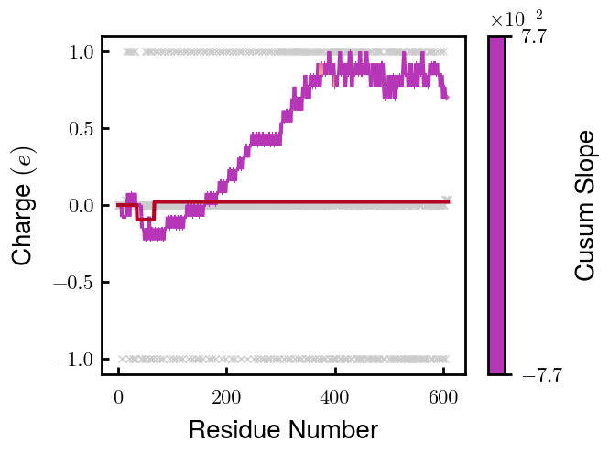
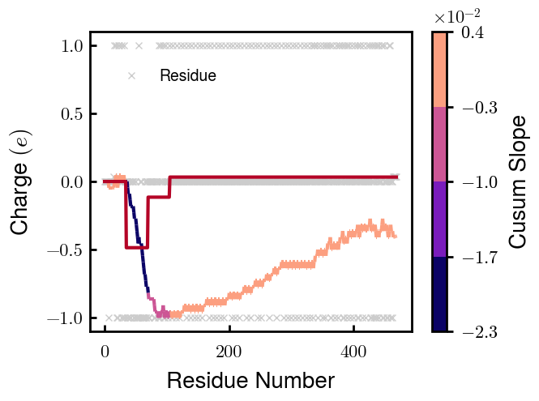
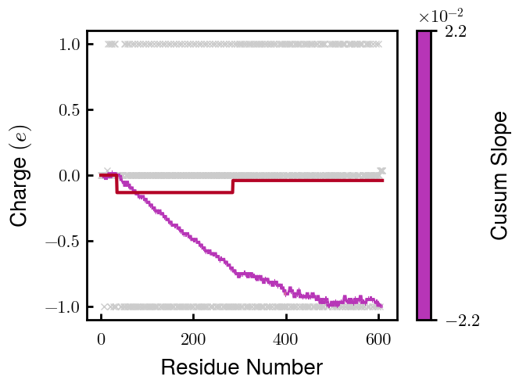
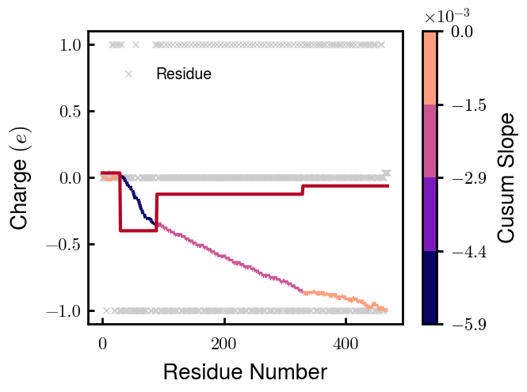
Coarse-grained Sequences (2 of 2)
NFM S1
NFM S2
NFH D2
NFH D6
Non-phospho
Phospho
—
—
Note: phospho $=−1e$ chosen for best agreement with experimentally measured heights

Slide 7
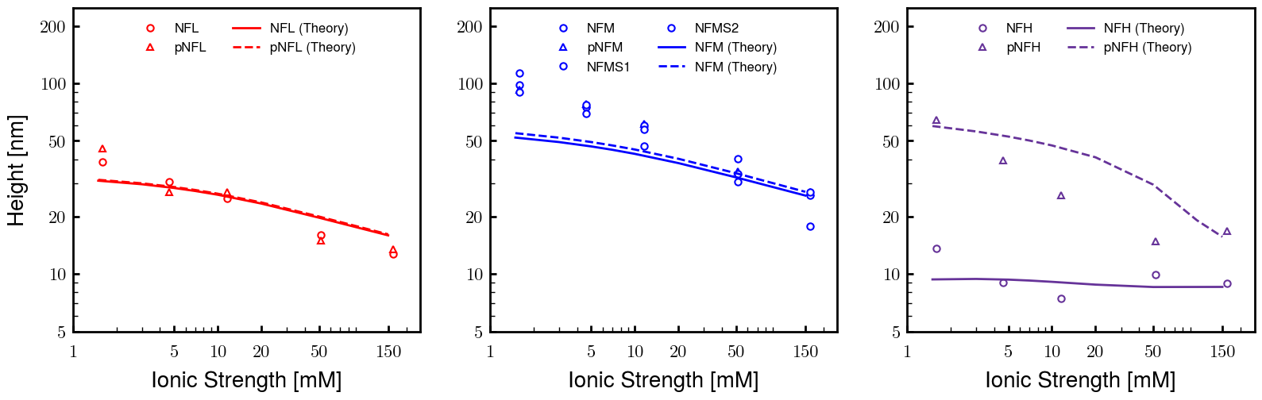
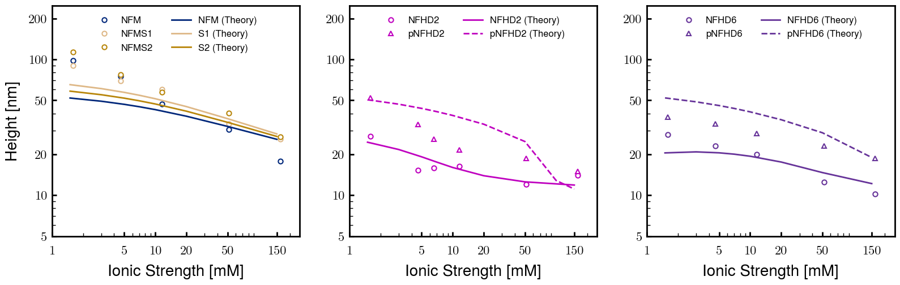
Agreement with AFM-measured heights
Non-modified
Modified

Slide 8
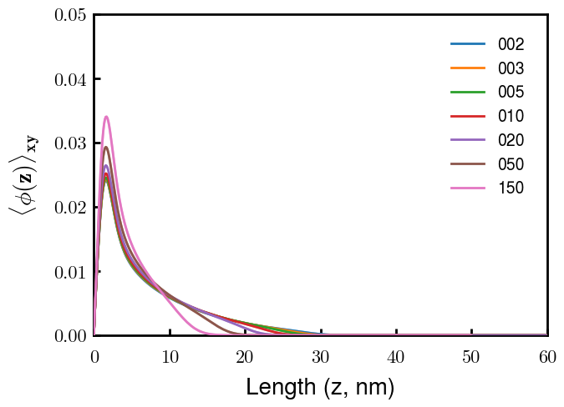
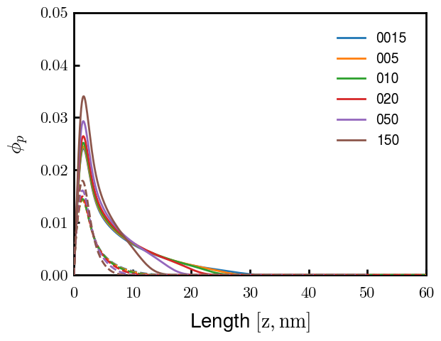
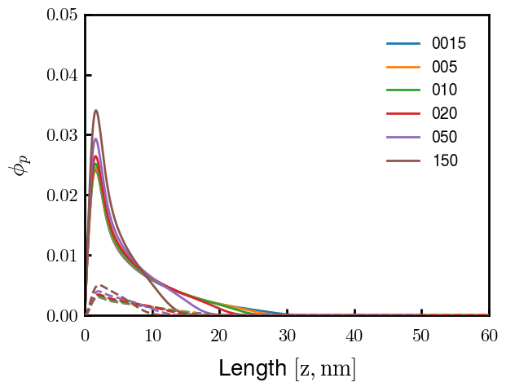
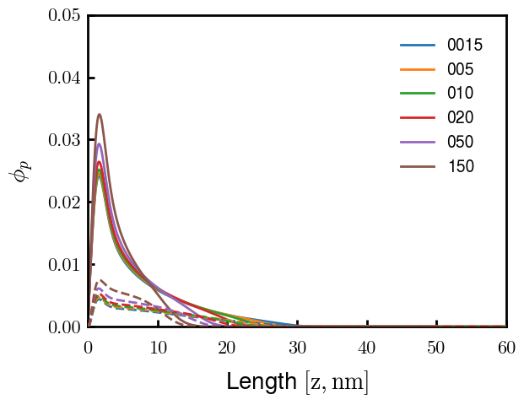
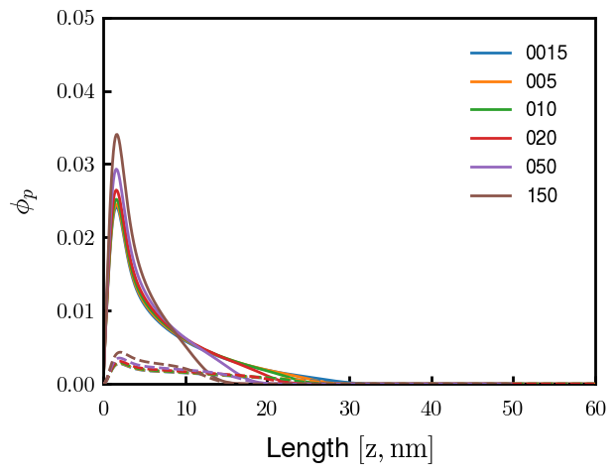
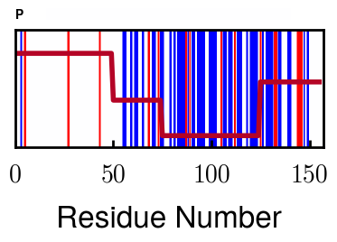
NFL
Sparse brush with 3rd block responsible for most of response to screening
1
2
3
4

Slide 9
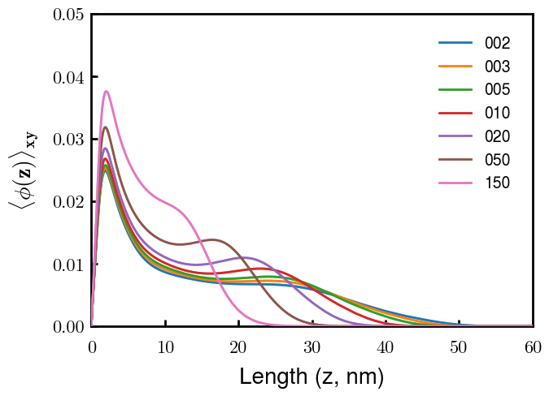
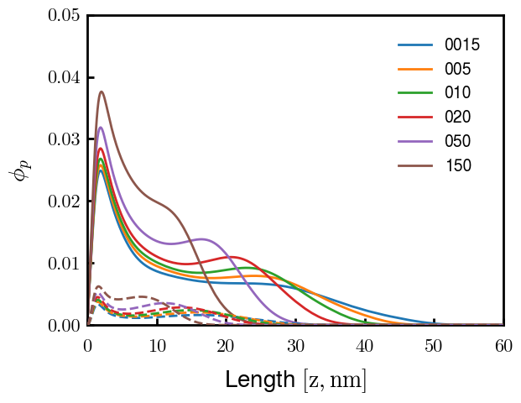
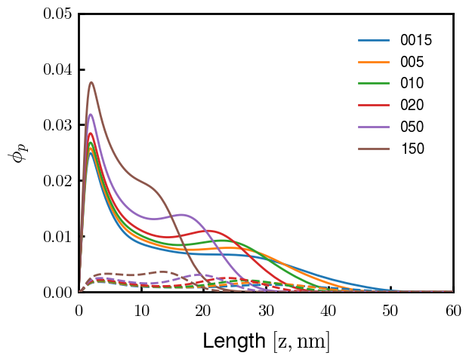
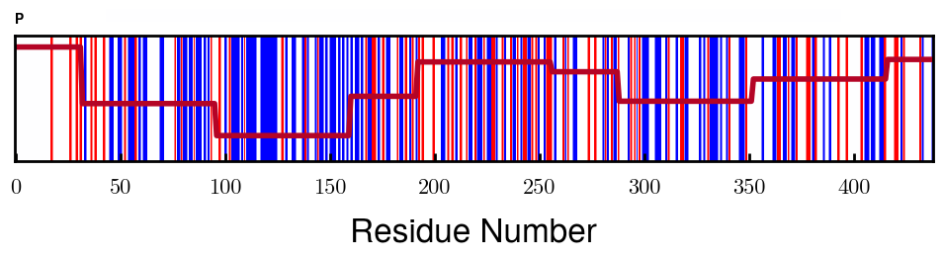
NFM
Shoulder in density distribution due to bimodal charge distribution
Fraction of chains in inner while rest in outer layer (fraction in inner layer decreases as screening decreases)
3
7

Slide 10
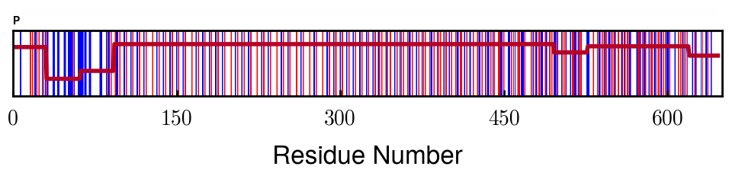
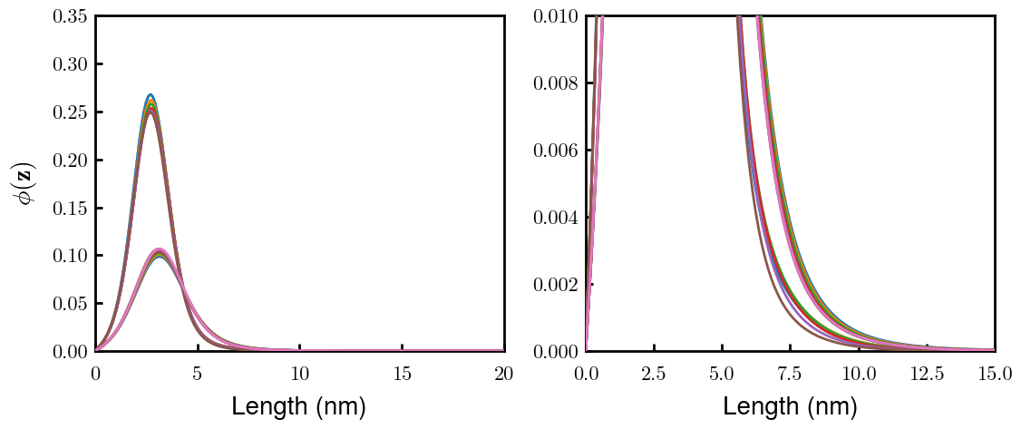
NFH(D2)
Height increase from loss of oppositely charged region
Note: Large decrease in brush volume due to lower D2 grafting density (in addition to loss of monomers): 0.03010 → 0.01854 c/nm2
Approximate D2 region
NFH
NFHD2

Slide 11
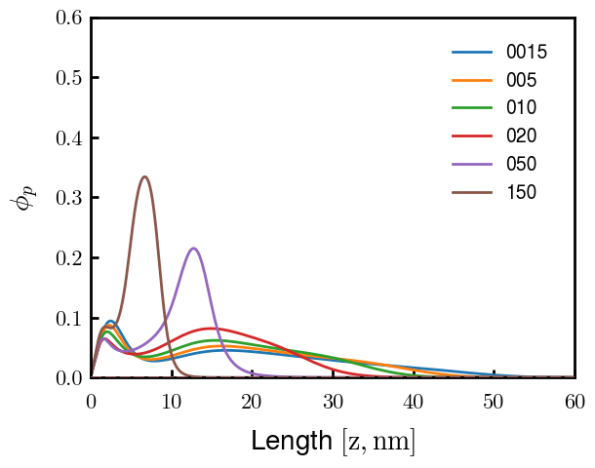
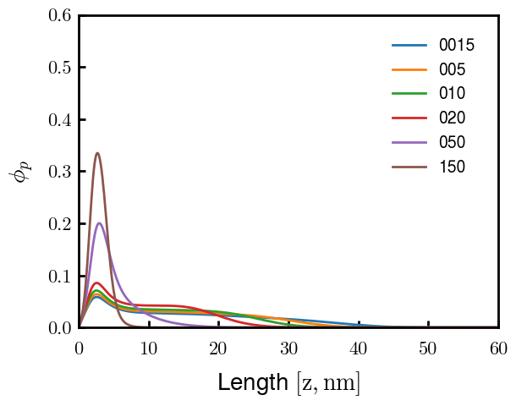
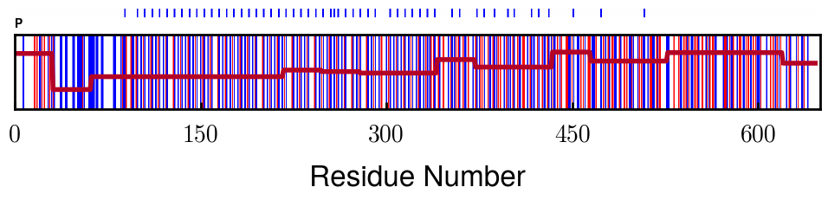
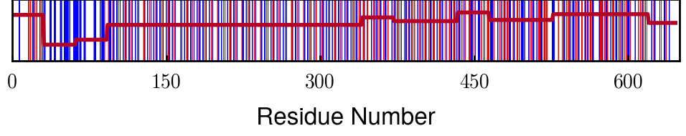
pNFH(D2) Option 1
2nd block responsible for forming second layer (looks like flower conformation previously reported for pNFH)
pNFH
pNFH_D2
Approximate D2 region

Slide 12
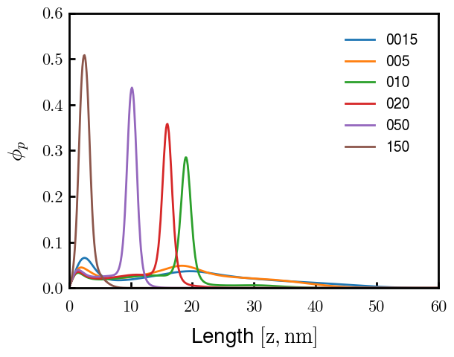
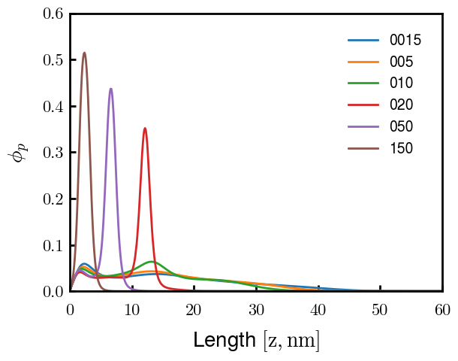
pNFH(D2) Option 2
Same conclusions as Option 1, but NFHD2 also forms second layer, just not as tall.
Approximate D2 region

Slide 13
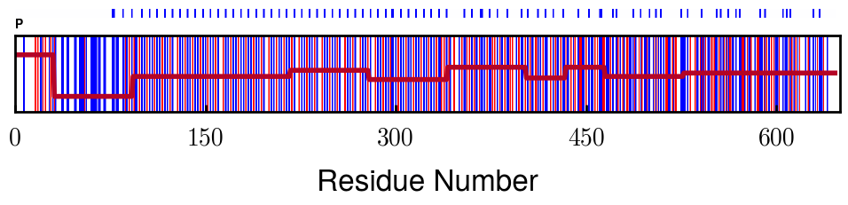
pNFH Options: Why
Option 2 changes F-H of Proline (increase) in pNFH(D2)
Originally testing F-H of Proline because Zhulina made P hydrophobic and expts reported P hydrophilic
However, changing F-H of Proline for NFH(D2) eliminates good fit with exptl values
Option 2 height response closest to exptl values in all testing
Phosphorylation may change F-H of KsP units
More rigorous method is to change F-H of phosphorylated s/t instead of P
Proline
Phos sites

